Slide 1
MBTI Personality Classification
JiaShuyi Fanclub
Team members: Jia Shuyi, Victoria Yong, Praveen
Notes:
Good morning Prof SJ, our team is called Jia Shuyi fanclub, named after Jia Shuyi himself, and our other team members are Victoria and Praveen.

Slide 2
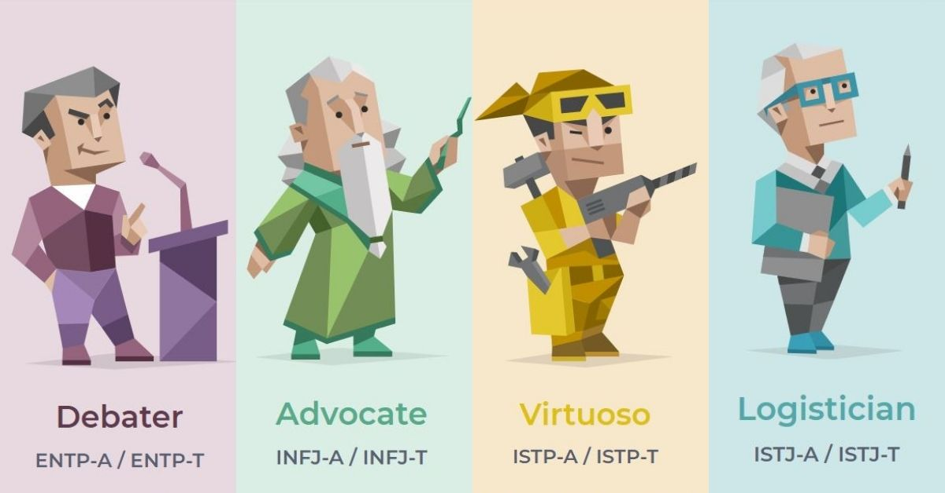
Overview
The Myers Briggs Type Indicator (MBTI) is a popular personality indicator representing the 4 different human psychological functions. Within each function, the classification is binary which leads to 16 different classes:
Extroverted (E) vs Introverted (I)
Intuition (N) vs Sensing (S)
Feeling (F) vs Thinking (T)
Judging (J) vs Perceiving (P)
Notes:
We would first like to introduce the Myers Briggs Type Indicator, also known as MBTI, which is a popular personality indicator of the 4 primary human psychological functions. Within each function, the classification is binary which results in a total of 16 classes. The 4 functions are:
Extroverted (E) vs Introverted (I)
Intuition (N) vs Sensing (S)
Feeling (F) vs Thinking (T)
Judging (J) vs Perceiving (P)

Slide 3
Objective
Predict the MBTI personality of an individual using their social media posts
Overview of predictive framework:
INTJ
String of texts
...
Pre-processing
Predictive model
INTP
...
ESFP
Notes:
Having come across a related dataset, we set out to predict the MBTI personality of an individual user their social media posts. The general idea for our predictive framework consists of preprocessing a string of texts from the social media posts, and passing the preprocessed texts through a predictive model, to obtain the personality of the individual.

Slide 4
The Dataset
An Example
INFJ
I live near Seattle. Just north of it. I moved back here a few weeks ago. Originally from puyallup area but moved from Phoenix.
83856 Me if I had a death wish
I am soooo freaking lonely! I cant stand whats going on in my head. Always my dreams shatter and are weaker than glass. Guhhhhhhhh hurt at my heart.
Back to feeling lost inside, had some time where I thought i was ok. I had a girlfriend learned alot at work, I am very ambisious. I want to suceed but feel Im not.
...
Kaggle MBTI Dataset
8675 rows
Each row contains:
MBTI personality
Last 50 social media posts
Notes:
The dataset was obtained from Kaggle and contains 8675 instances. Each row contains 2 columns; firstly the MBTI personality represented by 4 letters. The second column contains the last 50 social media posts written by the individual.
We can see an example on the right of a person with the INFJ personality, with 4 of their social media posts. Some things to pay attention to are highlighted in red, such as the random digits. There are also some colloquial or informal expressions such as so with many Os and Guh (these expression are indicators of intensity, which might be useful in some models). In addition, spelling errors are also a common occurrence.

Slide 5
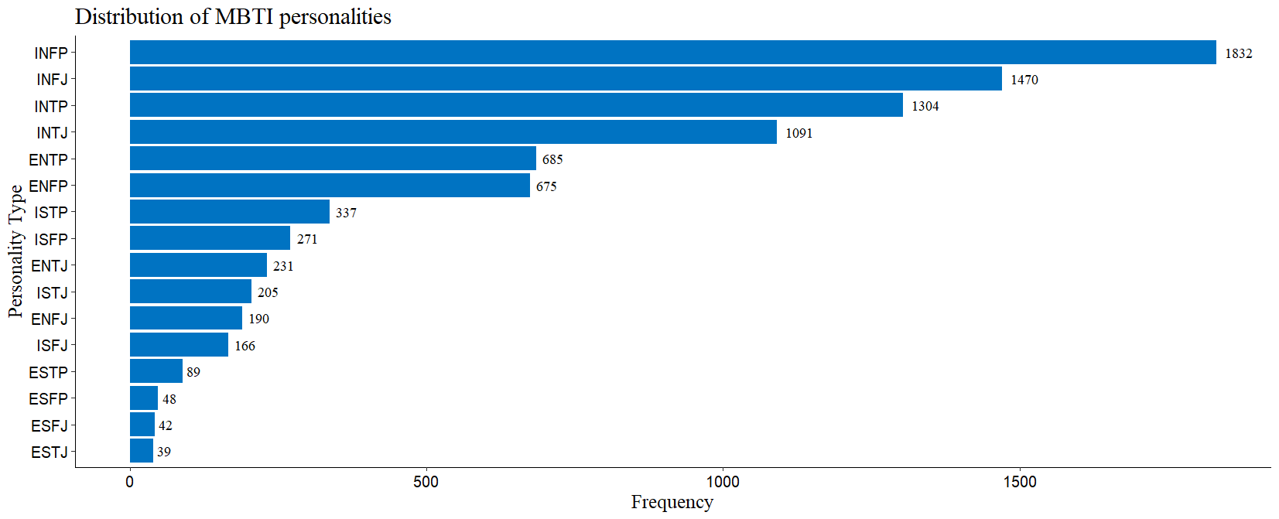
Visualising the dataset
Notes:
There are 8675 instances in total. The most frequent category, INFP alone makes up 22.1% of records with 1832 observations. In fact, the 4 most common personalities are all introverted personalities. One possible reason could be that introverted individuals are more likely to share their thoughts on the internet as compared to extroverts. Nevertheless, we still have close to 2000 records in total for extroverted individuals.

Slide 6
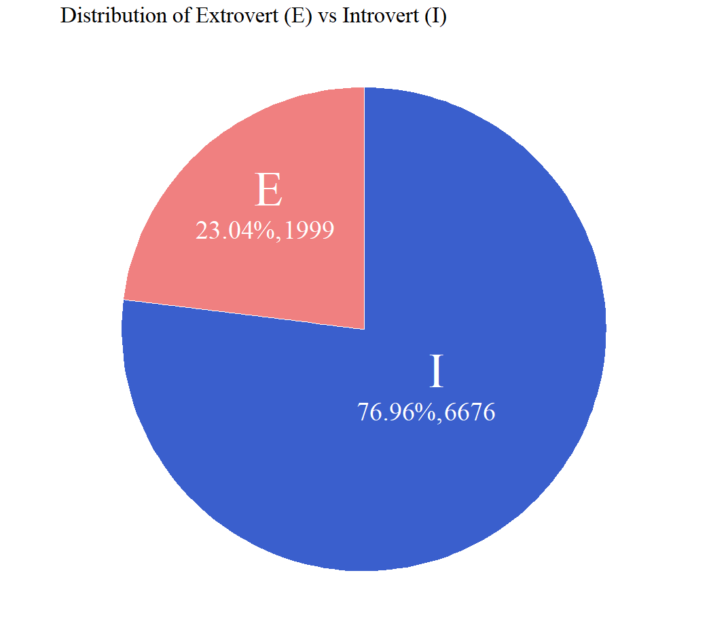
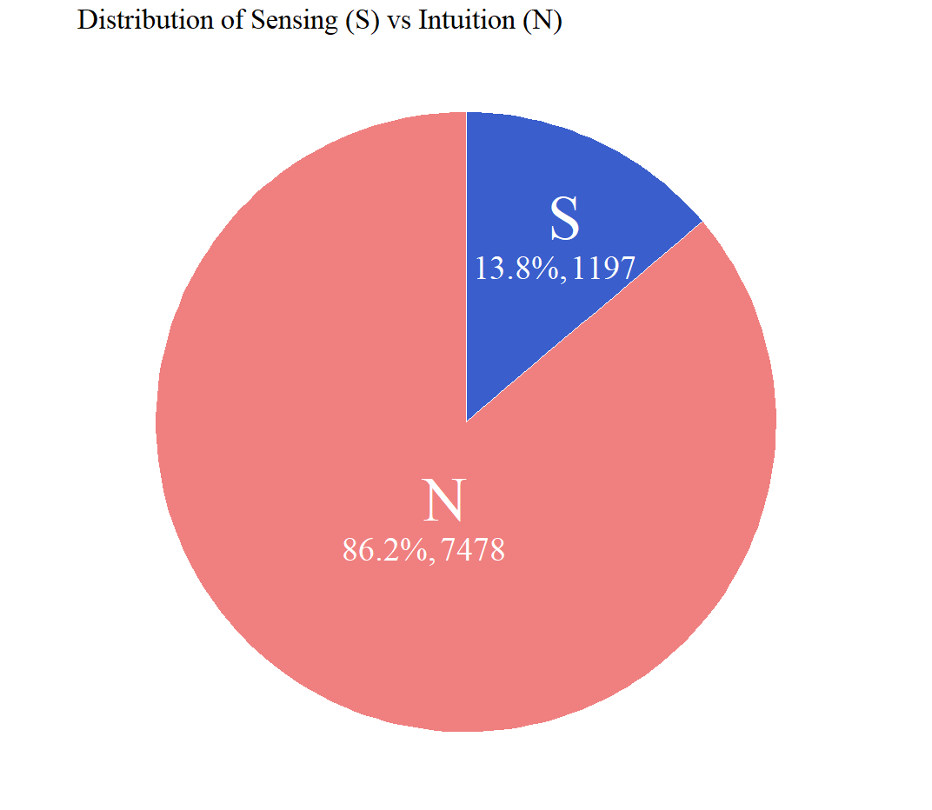
Visualising the dataset
Notes:
The dataset is noticeably skewed towards introverted individuals, who make up 77% of the records. There are also more observations for intuition at 86%, versus sensing which only makes up about 14%.

Slide 7
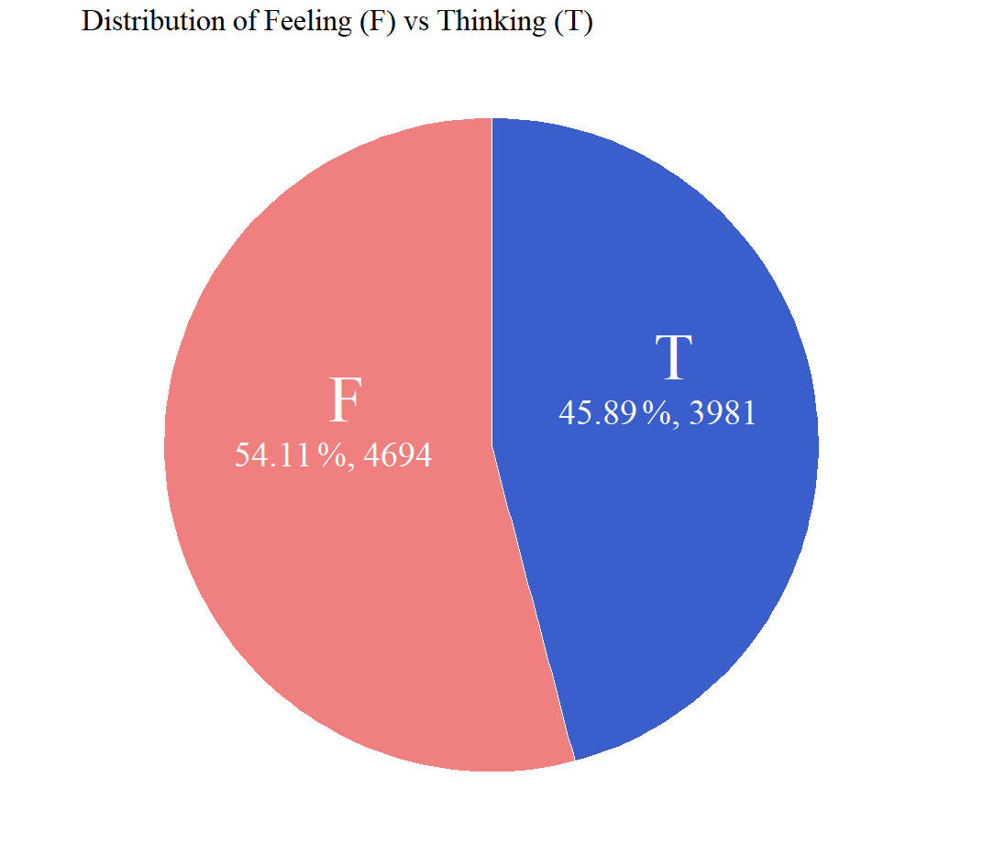
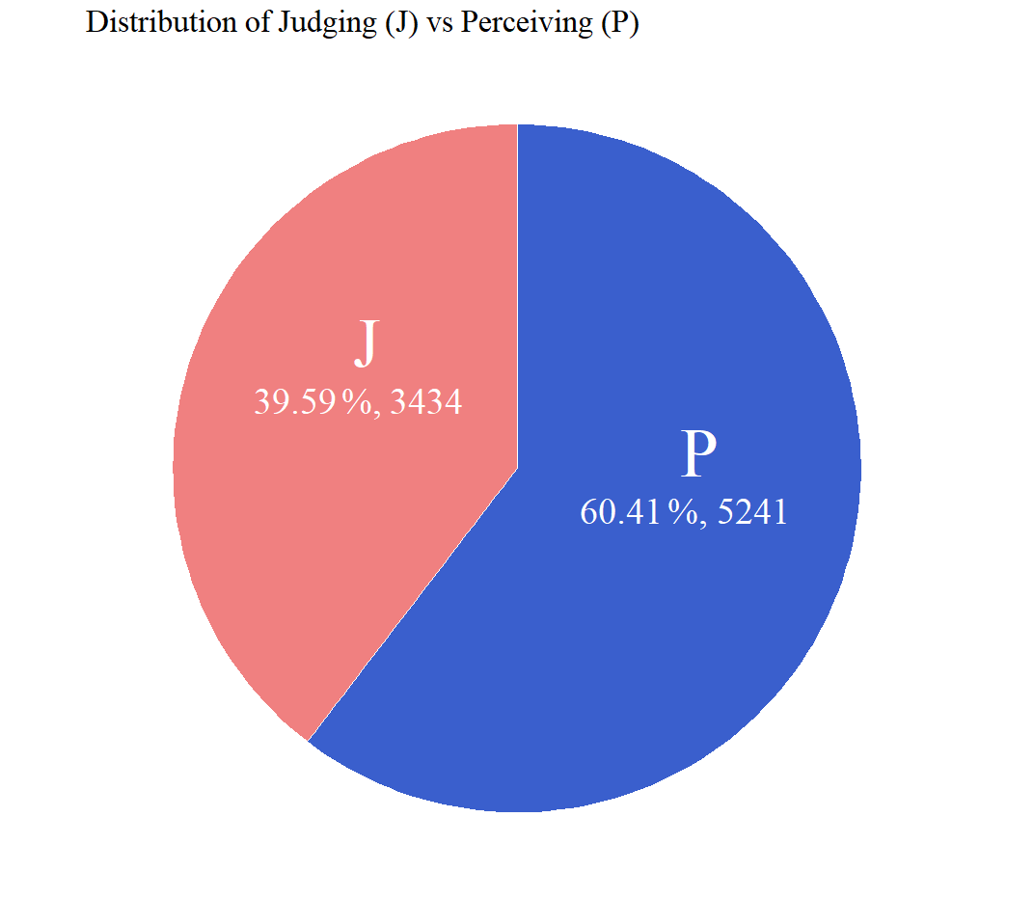
Visualising the dataset
Notes:
The remaining traits are reasonably balanced.

Slide 8
Data-Preprocessing (Multi-class)
Conducted to facilitate 2 types of model: multi-class and multi-label (binary)
For multi-class:
Removed all urls, special symbols + converted to lower casing
Used WordNet lemmatizer to convert words to their base forms (for Scikit-learn models only)
Spell correction on social media posts
Label encoded target classes (16 MBTI personalities)
TF-IDF vectorizer on training and test sets (for scikit-learn models)
Notes:
After looking at those visualisations, planned to build both multi-class and multi-label classification models. For multi-class, we conducted some preprocessing on the data to remove urls, special symbols, and convert texts to lower casing. WordNet lemmatizer was also used to convert words to their base forms and also spell corrected any misspelled words. The 16 target classes were tagged with integer labels using Label Encoder. Finally, we transformed both the test and training sets using the tf-idf vectorizer.

Slide 9
Data-Preprocessing (Multi-label)
For multi-label (binary):
Removed all urls, special symbols + converted to lower casing
Spell correction on social media posts
Target vector transformed to target matrix with binary encoding
Personality Type | is_I | is_N | is_T | is_J
ENFJ | 0 | 1 | 0 | 1
ISTP | 1 | 0 | 1 | 0
... | ... | ... | ... | ...
Notes:
For multi-label, we again conducted cleaning by removing urls and symbols, and performing spell correction, but the target vector was converted to a matrix with 4 binary labels. Here you can see an example of how the different personalities are represented.

Slide 10
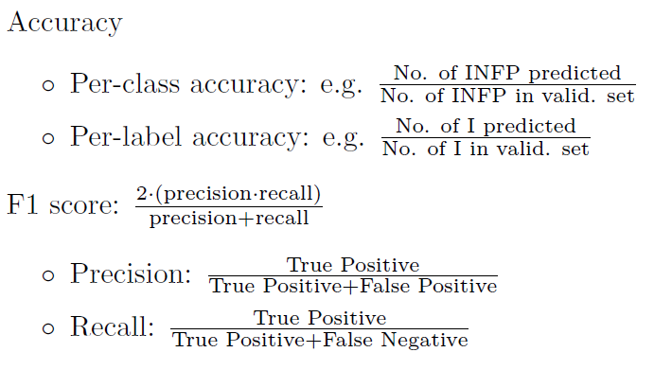
Evaluation Methodologies
Notes:
Before moving on to the different models, these are the main evaluation methodologies we used. These metrics were produced easily using the classification report module within scikit-learn.

Slide 11
Recap - Preliminary Models using SKLEARN
Base accuracy: 21.1% (by predicting that everyone is INFP - most common personality)
Explored sklearn models to attain baseline accuracy
Among models tested, linear SVM with default parameters resulted in test accuracy of 66.2%
Model | Accuracy
Linear SVM | 0.662
Logistic Regression | 0.624
Decision Tree | 0.500
Random Forest | 0.488
Multinomial Naive Bayes | 0.376
Notes:
To recap on the preliminary models presented previously, we first set the baseline accuracy at 21.1%, as that would be the performance of a naive model predicting everyone to be INFP. With the multi-class preprocessing described just now, we explored a few sklearn models to set a more reasonable baseline, and the results were not too bad. In particular, linearSVM had a respectable accuracy of 66.2%. From here on, we will aim to beat a baseline accuracy of 66.2%.

Slide 12
Doc2Vec + Logistic Regression
Represent documents as vectors via unsupervised learning of features in the text of each social media post
2 possible models to learn document and paragraph embeddings
Distributed Bag-of-Words (DBOW) - use of document IDs to predict randomly sampled words from the documents
Distributed Memory (DM) - use of documents IDs and context words to guess the output words
DBOW was more appropriate - multiple predicted words would allow a more confident classification of personality
Notes:
We began with unsupervised learning with Doc2vec and logistic regression. Doc2vec basically represents documents as vectors via unsupervised learning of features in the text of each social media post. There are 2 possible models, DBOW and DM. In our case, DBOW was more appropriate as it predicts multiple randomly sampled words from the documents, and this would pave a more confident classification of personality.

Slide 13
Doc2Vec + MultiLogistic Regression
Used DBOW to train both multi-label and multi-class classification models
Classifier | Accuracy | F1-scores range
Multi-Class | 0.534 | 0.06 - 0.75
Multi-Label | 0.472 | 0.66 - 0.94
 | Precision | Recall | f1-score | Support
is_I | 0.85 | 0.92 | 0.89 | 2017
is_N | 0.91 | 0.97 | 0.94 | 2264
is_T | 0.81 | 0.80 | 0.81 | 1195
is_J | 0.70 | 0.62 | 0.66 | 1054
Notes:
We trained both multi-label and multi-class classification models. Within the 2 models, multi-class had a better overall accuracy but worse F1 scores. Both models performed worse than LinearSVM. The F1 scores for the multi-label model was encouraging as it showed that we were headed in the right direction. Effectively, we were able to accurately predict each label, but fell short only when the predicted labels were concatenated and compared against the actual personalities. This means that for overall accuracy to improve, every label must be predicted accurately.

Slide 14
 | Precision | Recall | f1-score | Support
ENFJ | 0.29 | 0.30 | 0.30 | 53
ENFP | 0.53 | 0.52 | 0.52 | 201
ENTJ | 0.34 | 0.37 | 0.35 | 60
ENTP | 0.57 | 0.45 | 0.50 | 206
ESFJ | 0.12 | 0.06 | 0.08 | 17
ESFP | 0.05 | 0.07 | 0.06 | 14
ESTJ | 0.15 | 0.20 | 0.17 | 10
ESTP | 0.12 | 0.12 | 0.12 | 25
INFJ | 0.63 | 0.67 | 0.65 | 450
INFP | 0.69 | 0.72 | 0.70 | 542
INTJ | 0.63 | 0.52 | 0.75 | 355
INTP | 0.61 | 0.68 | 0.64 | 397
ISFJ | 0.29 | 0.32 | 0.30 | 53
ISFP | 0.40 | 0.32 | 0.35 | 78
ISTJ | 0.24 | 0.29 | 0.26 | 56
ISTP | 0.49 | 0.51 | 0.50 | 86
Notes:
In comparison, the multi-class model had pretty lacklustre F1 scores. It was evident that the overall accuracy was skewed as the prediction accuracies were better only for the more populated classes, and quite terrible for the under-represented classes highlighted in yellow.

Slide 15
Neural Network Models - LSTM & BERT
Additional preprocessing and training steps:
Preprocessing
Tokenize texts
Positional embeddings (for BERT)
Training
Fine-tuning of pretrained model (BERT)
Learning rate scheduling
Notes:
Having narrowed down to multi-label models, we set out to use neural networks to better capture semantic meaning of the texts and improve overall accuracy of the models. For the 2 models we chose, LSTM and BERT, we had to do a bit more pre-processing such as tokenization, which also includes positional embeddings for BERT. On the training side, which was expected to take noticeably longer, we made use of learning rate scheduler to speed up training, and fine-tuned the parameters in BERT to suit our multi-label target.

Slide 16
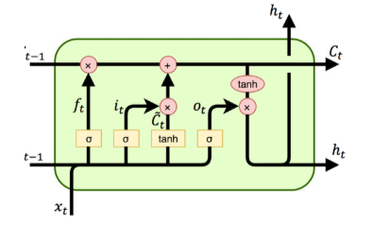
Neural Network Models - LSTM
Use of internal states
Pass info linearly to next recurrent step
Pass info non-linearly to hidden states
Gating mechanisms to control flow of info
Forget gate: how much info from previous internal state to leave out
Input gate: how much info from current state to retain
Output gate: how much info from current state to pass to hidden state
Notes:
Firstly, we looked at LSTMs due to their used internal states to decide how much info to pass on the next recurrent steps and hidden states. Gating mechanisms were used to dictate the control of info, and these included forget, input and output gates.

Slide 17
Neural Network Models - LSTM
LSTM networks are an improvement over recurrent neural networks (RNNs) which were plagued by the vanishing/exploding gradients issue
As unsupervised learning with Doc2Vec worked better with multi-label classification, we only trained a multi-label classification model with LSTM
Notes:
In comparison to vanilla recurrent neural networks, LSTMs were better equipped to handle the problem of vanishing and exploding gradients. As previously mentioned, we saw that Doc2vec worked better with multi-label, so we only built multi-label classification models with LSTM, and also BERT later on.

Slide 18
Results - LSTM
Overall validation accuracy: 73.3% - improvement over scikit-learn and DBOW models 😎
 | Precision | Recall | f1-score | Support
is_I | 0.85 | 0.95 | 0.90 | 2017
is_N | 0.89 | 0.99 | 0.94 | 2264
is_T | 0.85 | 0.85 | 0.85 | 1195
is_J | 0.63 | 0.46 | 0.53 | 1054
Notes:
The results were much better, and the F1 scores were on par with Doc2vec. However, the is_J variable, which classifies someone as either judging or perceiving, had a noticeably worse F1 score, presumably due to the lower number of observations.

Slide 19
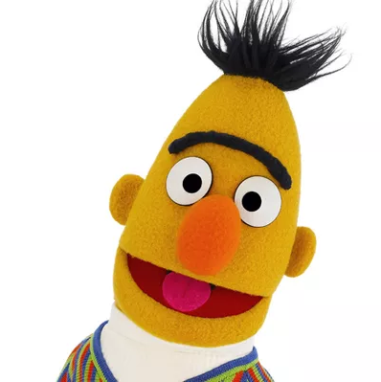
Neural Network Models - BERT
Pre-trained on a large corpus (including the whole of Wikipedia and much more) to achieve better classification results
BERT is bidirectional, and features positional embeddings (in addition to token embeddings) - even better at learning semantic meaning of words in different contexts
E.g. “Bank”
Notes:
To address this issue, we used BERT, which was pre-trained on a large corpus, which includes the whole of Wikipedia and even more. BERT is bidirectional, and with positional embeddings, it is even better at learning semantic meanings. For example, the word bank has different meanings as you could be referring to river banks or normal financial banks. BERT is able to learn this difference.

Slide 20
Neural Network Models - BERT
Added a linear layer to convert BERT representations for a binary classification task
Long training period - use of learning rate schedulers to speed up the process
Notes:
To facilitate our binary multi-label classification, we finetuned BERT by adding a linear layer. The training period was expected to take several hours, so we used learning rate schedulers to speed up the process.

Slide 21
Results - BERT
Overall validation accuracy: 77.2% - even better! 😎
 | Precision | Recall | f1-score | Support
is_I | 0.88 | 0.86 | 0.87 | 2017
is_N | 0.88 | 0.99 | 0.93 | 2264
is_T | 0.80 | 0.72 | 0.76 | 1195
is_J | 0.58 | 0.13 | 0.22 | 1054
Notes:
The overall accuracy once again improved! Unfortunately, the F1 score for the is_J variable worsened even further, as there were several false negatives in this classification.

Slide 22
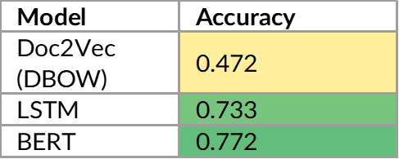
Results - Summary (Multi-label only)
Notes:
Nevertheless, the pretrained BERT had the best accuracy among all of our models.

Slide 23
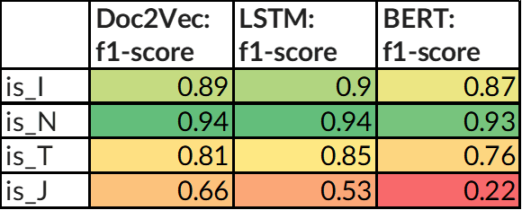
Results - Summary (Multi-label only)
Notes:
The F1 scores were a strong for Doc2vec and LSTM, and also reasonably strong for BERT except for is_J.

Slide 24
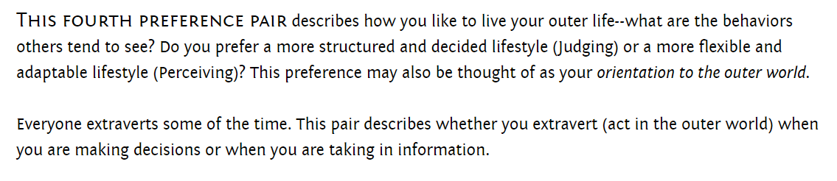
Implications
All models showcase poor accuracy in classifying a person as Judging (J) or Perceiving (P)
Notes:
Which brings us to implications. All models were noticeably worse in classifying the 4th psychological function. On the MBTI website, this function is classified based on how a person likes to live their outer life, and the behaviours that others tend to see. It is possible that the social media posts were not great at depicting this aspect of an individual, as we all may have seen news reports that on social media, people tend to portray themselves more favourably, even if that is not their true self.

Slide 25
Implications
Models can still be used to classify the other 3 psychological functions with high confidence
Choice of model would depend on use case:
If accurate classification of each label is more important, can use:
LSTM - slower to train, but more accurate with texts outside of corpus
Doc2vec - faster to train, but likely poor accuracy on texts outside of corpus
If accurate classification of overall personality is more important, can use:
BERT - however, “J vs P” classification is the worst with this model
Notes:
Nevertheless, all 3 of the models, Doc2vec DBOW, LSTM and BERT can still be used to individually predict the other 3 psychological functions with a high confidence. The choice of the model would boil down to the use case:
If accurate classification of each label is more important, then we can choose between LSTM or Doc2vec. LSTM is slower, but on data outside of the corpus, it is more likely to return an accurate prediction. Doc2vec is faster to train, but likely to have a poor performance on a document outside of the corpus.
If the overall accuracy is more important, BERT is the way to go, but users must be weary of the weakness in classifying between J and P.

Slide 26
Conclusion
Considering both accuracy and F1-scores, our team strongly recommends using transfer learning with BERT
However, for some use cases (e.g. medical diagnosis of specific psychological functions), the user can consider making use of LSTM
Notes:
In conclusion, if we take all metrics into account, we strongly recommend BERT. But LSTM can still be considered for some use cases, such as medical diagnosis where specific classifications may be more important.

Slide 27
Thank You!

Slide 28
For the initial check-o (Week 8), the teams should describe the type of dataset selected
or collected, the problem they aim to address, data visualisation, and a preliminary naive
model implemented based on one dataset.
An initial presentation as described in Section 3. This component serves to provide
feedback and check that there is progress. It is worth 5 marks.

